Slide 1
HACK GUJARAT
Team : Geek Tribe
LEADER : Mihir Sonaria
MEMBER : Rahulkumar Shiyani

Slide 2
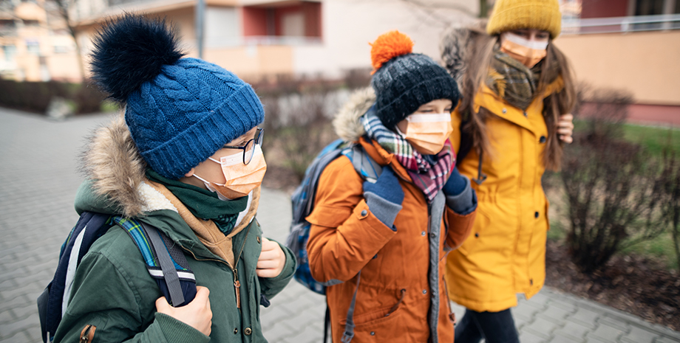
ADHYAYAN SCHOOL

Slide 3
What precautions should the school be taking to prevent COVID-19 virus from spreading?
School reopenings should be consistent with each country’s overall COVID-19 health response to help protect Students, Staff members, Teachers, Principal and their families. Some of the practical measures that schools can take include:
Staggering the start and close of the school day
Staggering mealtimes
Moving classes to temporary spaces or outdoors

Slide 4
How will the school support the mental health of students and combat any stigma against people who have been sick?
Will any of the school’s safeguarding and bullying policies change once schools start to re-open?

Slide 5
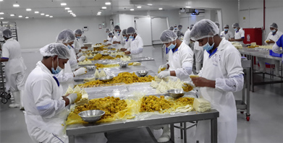
Practice Good Hygiene
Avoid touching your face
Avoid shaking hands
Cover your cough or sneeze with your arm or a tissue, not your hand
Wash your hands frequently with soap and water for at least 20 seconds, especially after eating, using the restroom, or coughing or sneezing

Slide 6
Health and Safety
The success of creating a safe and healthy campus for those who are on-site is a shared responsibility. Our entire community must come together to be part of the solution, caring for one another and our neighbors.
All students and employees will receive training on health and safety protocols and practices prior to returning to campus.
Physical Distancing & Facial Coverings
If you are among those approved to work or live on campus, please bring a supply of at least five cloth face coverings to have on-hand when you arrive on campus.

Slide 7
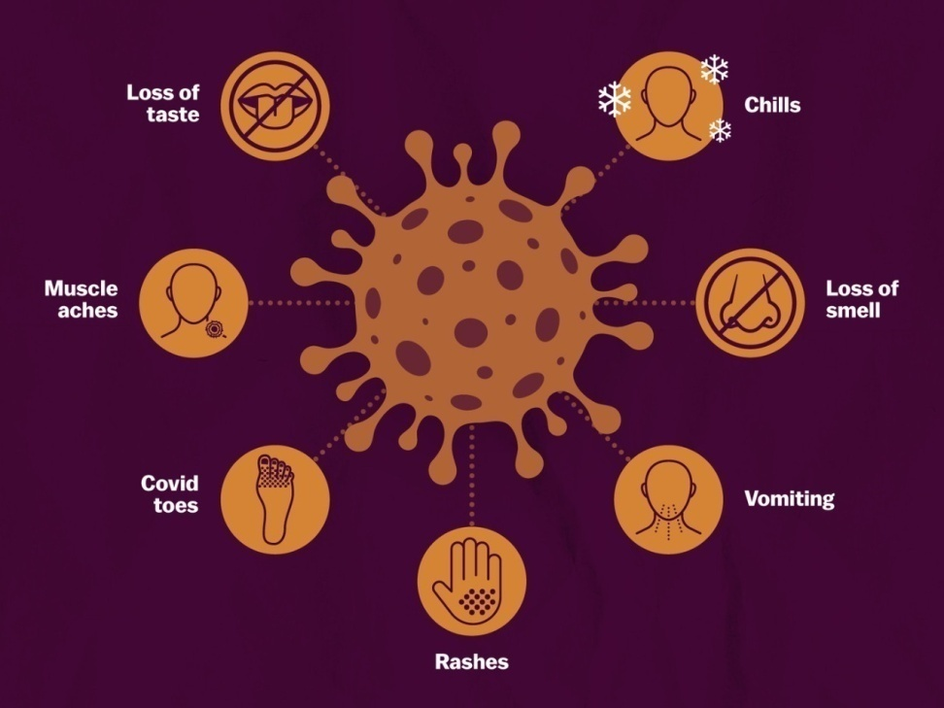
Symptom Checks
Students
Students will fill out a COVID-19 symptom check questionnaire each day prior to being on campus premises. Symptom checks include assessing for cough, shortness of breath or fever, and any other symptoms the student may be experiencing. These symptom checks and a temperature check should be done remotely before arriving on campus.
Faculty and Staff
All employees must complete a symptom check before arriving on campus for work. View the Employee Health Screening Process for additional information.

Slide 8

Sanitization
Cleaning and sanitation of buildings, classes, and public spaces occur frequently and according to strict protocols and health and safety guidelines. Also, hand sanitizing stations are available in numerous accessible locations.
Our individual actions can help stop the spread of COVID-19. Members of the Campus share the responsibility to do our part and are encouraged to:
Frequently wash your hands with soap and water, or use hand sanitizer.

Slide 9
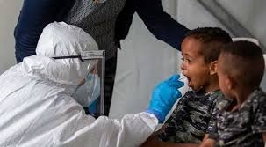
COVID-19 Testing
Enhanced Cleaning and Disinfecting Protocols
Public areas and restrooms cleaned daily by Facilities Management.
Hand sanitizer available at all building entrances open to the public. (Some entrances may be closed.)
Face Covering and Physical Distancing.

Slide 10
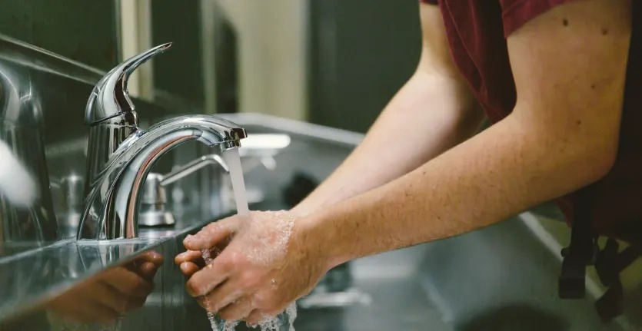
Tips to prevent illness On campus
Wash Your Hands
Viruses can spread easily in enclosed and shared spaces. For students who commonly share communal areas such as lecture halls, study tables, and dorm rooms, practicing good hand hygiene is one of the best ways to reduce the risk of contracting and transmitting a viral infection.

Slide 11
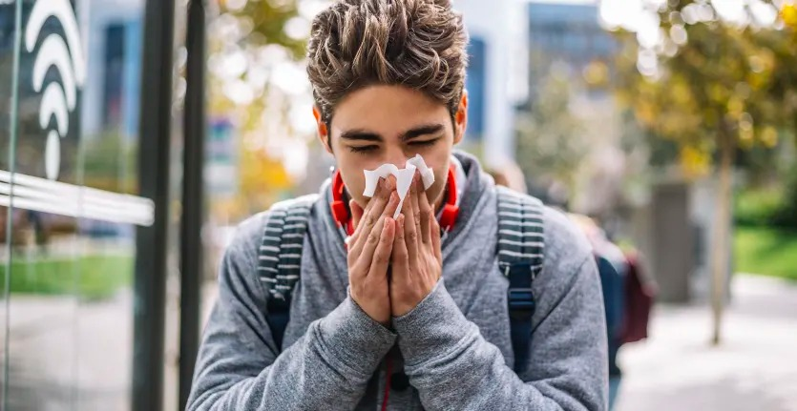
Cover Coughs and Sneezes
Viruses commonly spread through airborne respiratory droplets from coughs and sneezes. In these droplets, a virus can travel about 3-6 feet and infect people nearby or land on hard surfaces.
Use the crook of your elbow or a tissue to prevent your fellow classmates from becoming infected.

Slide 12

Disinfect Touched Objects and Surfaces
In school, where many objects and surfaces are shared among students on campus, viruses can spread quickly. Studies have shown that flu viruses, for example, can survive up to 48 hours on hard surfaces.

Slide 13
What to Do if You Get Sick at school
Take Care of Yourself
“If you're sick, staying at home and resting is by far the most efficient way of getting healthy,” This means resting, eating healthy, drinking plenty of fluids, and avoiding contact with other people.
Let Your Professors Know
If you know you're going to miss a few days of class, “communicate with professors electronically to stay on top of assignments, as opposed to attempting to go to class or office hours,” Continue to keep your professors updated about your situation through email if your illness worsens.

Slide 14


